Slide 1
ST1505:
Are you
smarter than an
AI?
Soh Hong Yu
P2100775
DAAA/FT/2B/01

Slide 2
Table of Contents
Mercury
Planet Mercury is the closest object to the Sun
DevOps Process
MLOps
Mars
Despite being red, Mars is a cold place
Model Development
Web Application Development
Jupiter
Jupiter is a gas giant and the biggest planet
Automatic Testing
Robotic Process
Automation

Slide 3
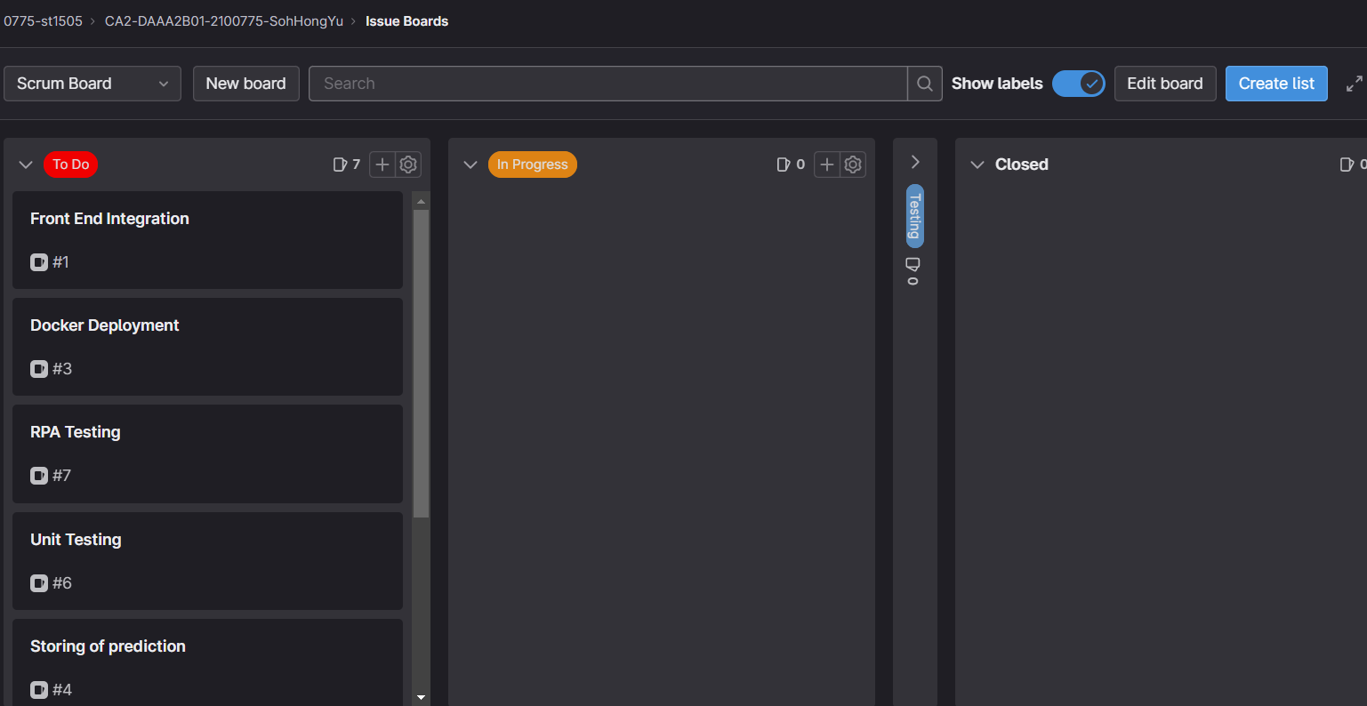
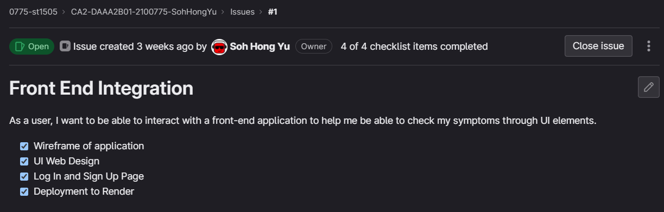
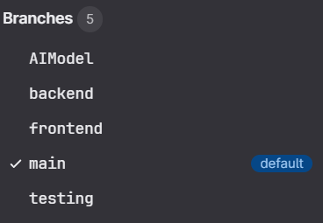
DevOps Process
Before developing the application, we need to do some scrum boarding. This allows us to keep track of our application development. [To Do, In Progress and Testing Labels]
After doing the scrum board, it is time to make branches. This allow us to make changes to the folder in a controlled environment.
[No of Branches: 5]

Slide 4
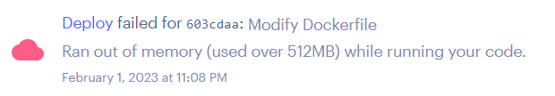
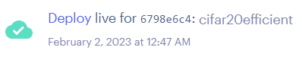
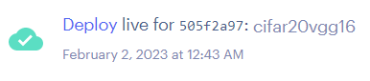
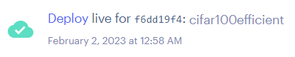
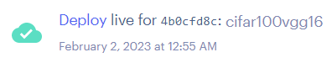
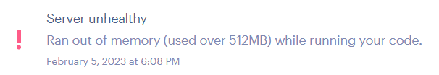
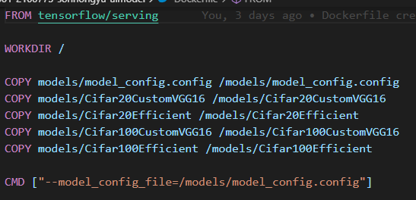
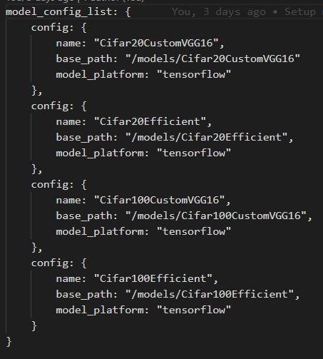
Model Development
Due to Render’s lack of memory and the size of the Deep Learning(DL) models, I have separated the DL models into 4 separate Render URL.
But I have also deploy the 4 models together on LOCAL DockerFile into the same URL.
We need to note that Render’s processing and computational power is not very strong. Models like EfficientNetV2 and ResNetV2 will have issues with memory!
DL Models used:
Fine
VGG16
EfficientNetV2
Coarse
VGG16
EfficientNetV2

Slide 5
Automatic Testing

Slide 6
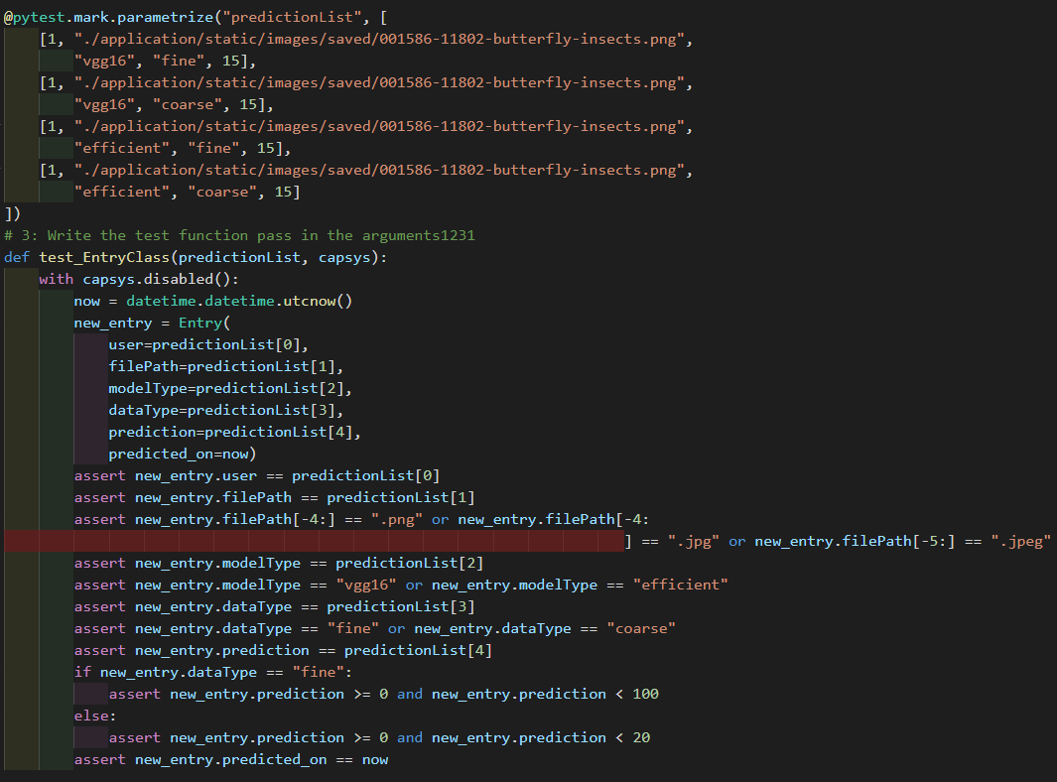
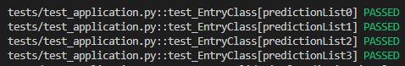
Unexpected Failure Testing
We create a test for unexpected failure testing using some of the data and send to the SQLLite Table.
We can see that all the results has passed as we did not expect any failure.

Slide 7
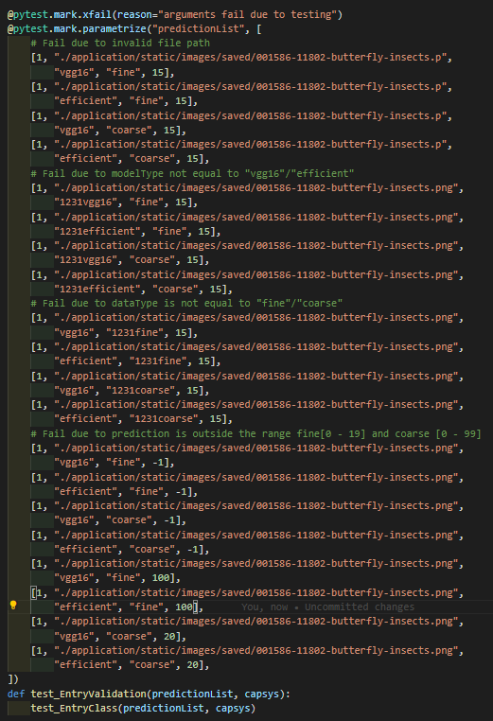
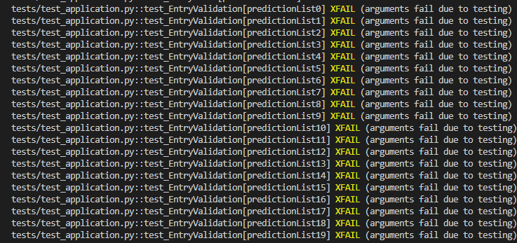
Expected Failure Testing
We will be using the same function as the unexpected failure testing. This allows us to moderate and check for any of the data has any outliers that was not validated.
Issues that might occurs:
What happens if imgPath is invalid?
What happens if modelType is not equal to “vgg16" / "efficient"?
What happens if dataType is not equal to "fine" / "coarse"?
What happens if prediction is outside the range fine[0 - 19] and coarse [0 - 99]?

Slide 8
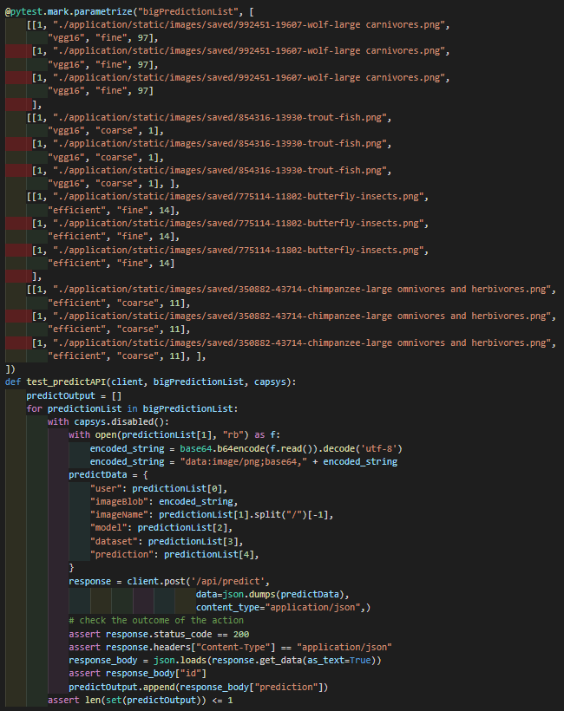
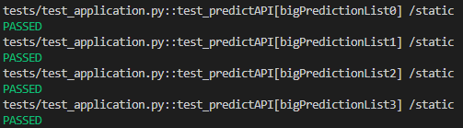
Consistency Testing
We group arrays into 3 array of random index. The array in an array will be looped through, then the values are feed into the AI Model to test if the output prediction is consistent.

Slide 9
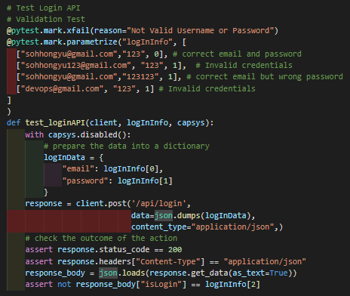
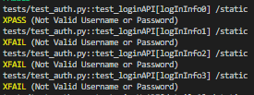
Validation Failure Testing
We check if there is any issue or validation error in the parameter. We also validate and ensure the data is inside of the database beforehand.
We see as the first is a valid email and password, it is a XPASS while the rest have issues and are XFAIL

Slide 10
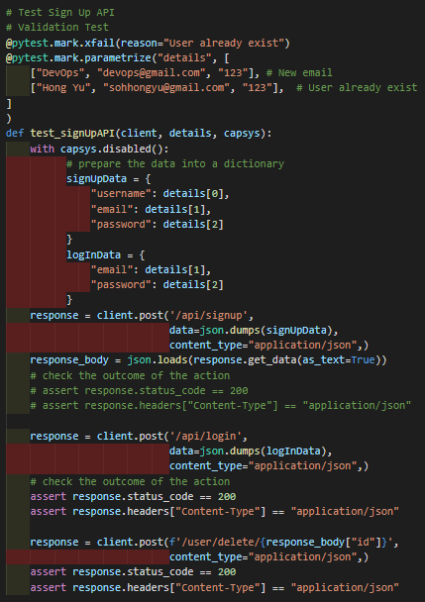
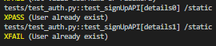
Endpoint API Testing - Sign Up
We will be testing the sign up endpoint of the application. We will be testing a new email and a user that already exist in the database.

Slide 11
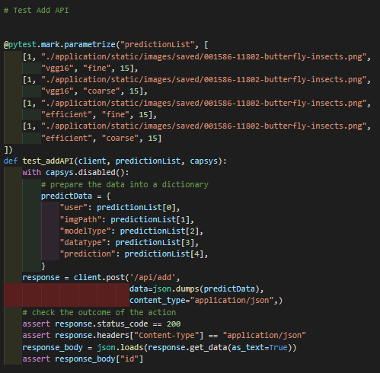
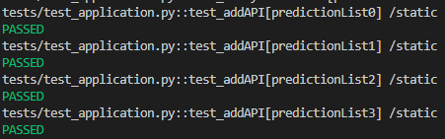
Endpoint API Testing - Add
To add the data, we will be using the “/api/add” endpoint

Slide 12
Endpoint API Testing - Add
To add the data, we will be using the “/api/add” endpoint

Slide 13
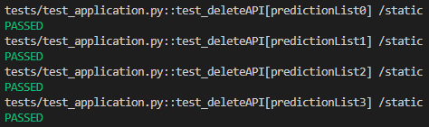
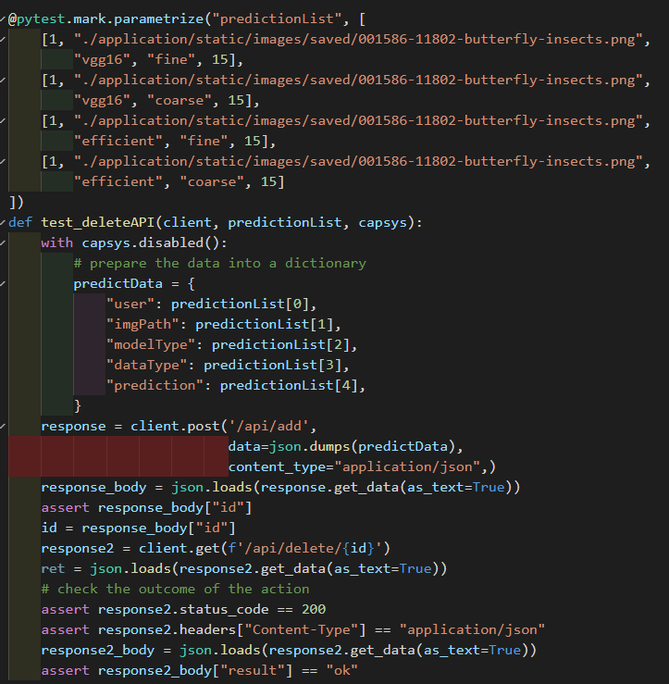
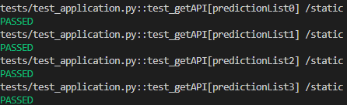
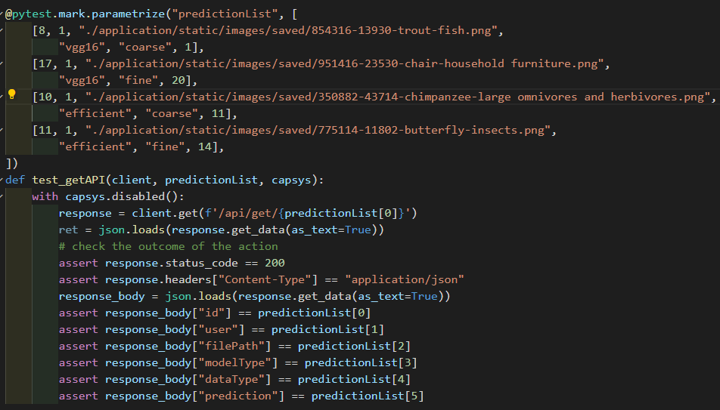
Endpoint API Testing - Get & Delete
We will look at the different rows to look and see if the output is the same as the one in the parameters

Slide 14
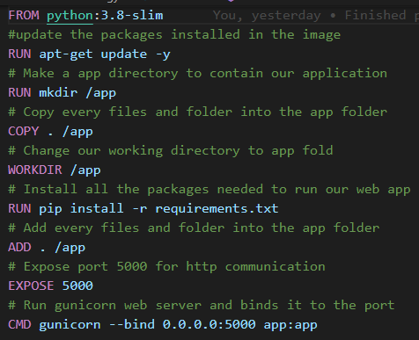
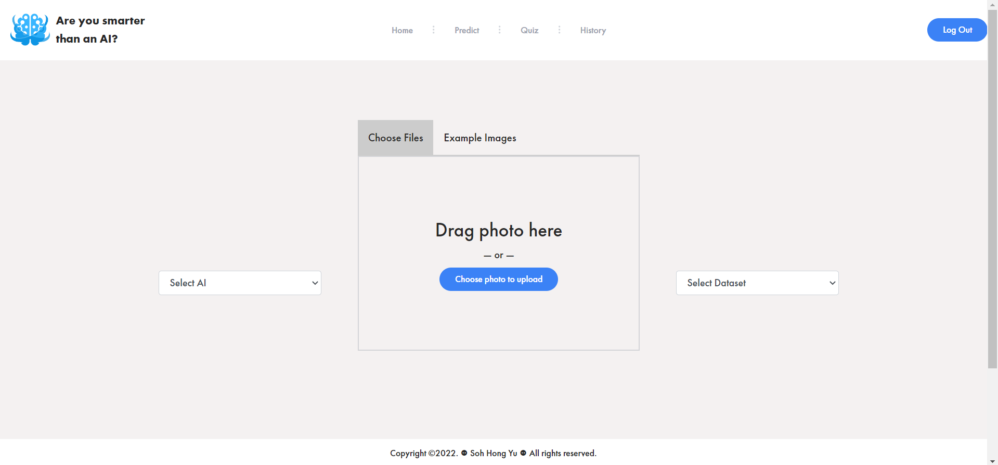
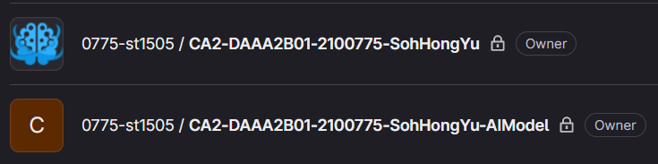

MLOps (Deployment)
To deploy the model / website to the internet, we will be using the platforms Render. The Render will run the Docker files that uses gunicorn as the WSL Server to host the website online.
https://areyousmarterthanai.onrender.com/

Slide 15

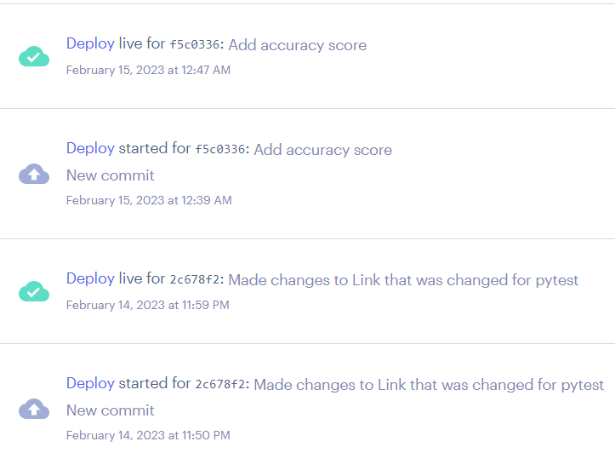
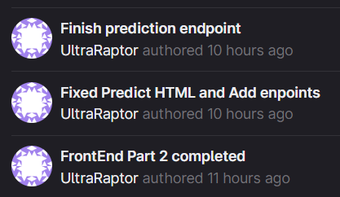
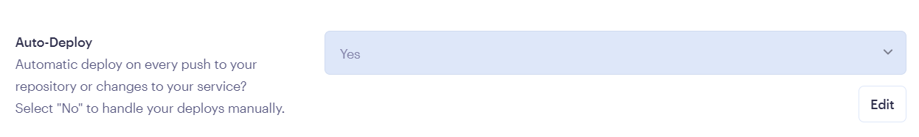
MLOps (CI/CD)
After deploying the models/website on Render, this gives us the opportunity to practice Continuous Integration and Continuous Deployment.
As Render has an Auto-Deployment feature, this allows the application to be deployed when a new push(changes) are made. (CD)
To assist us with Continuous Integration, we will be using a GitLab repository and the different branches to develop features and integrating it into the main branch.
Source: https://docs.aws.amazon.com/codepipeline/latest/userguide/concepts-continuous-delivery-integration.html

Slide 16
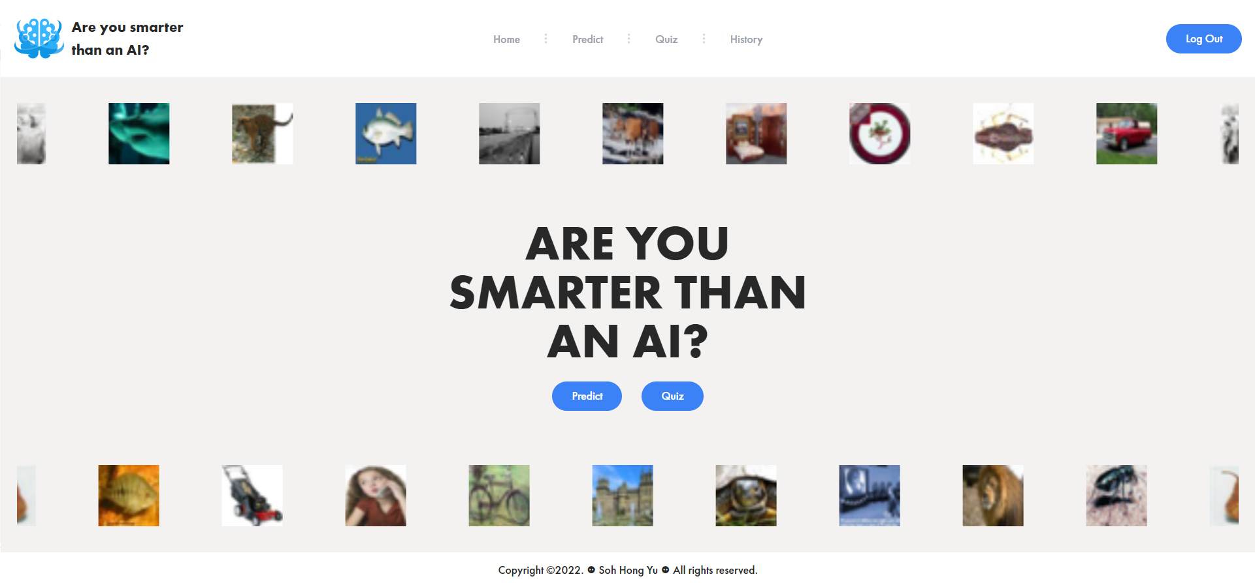
Introducing … Are You Smarter than an AI?
An application that users can use to predict images as well as compete in a quiz with the AI to see who is smarter [You or AI]?
Users can also view history to review their mistakes to help improve themselves for future quizzes.
https://areyousmarterthanai.onrender.com/

Slide 17
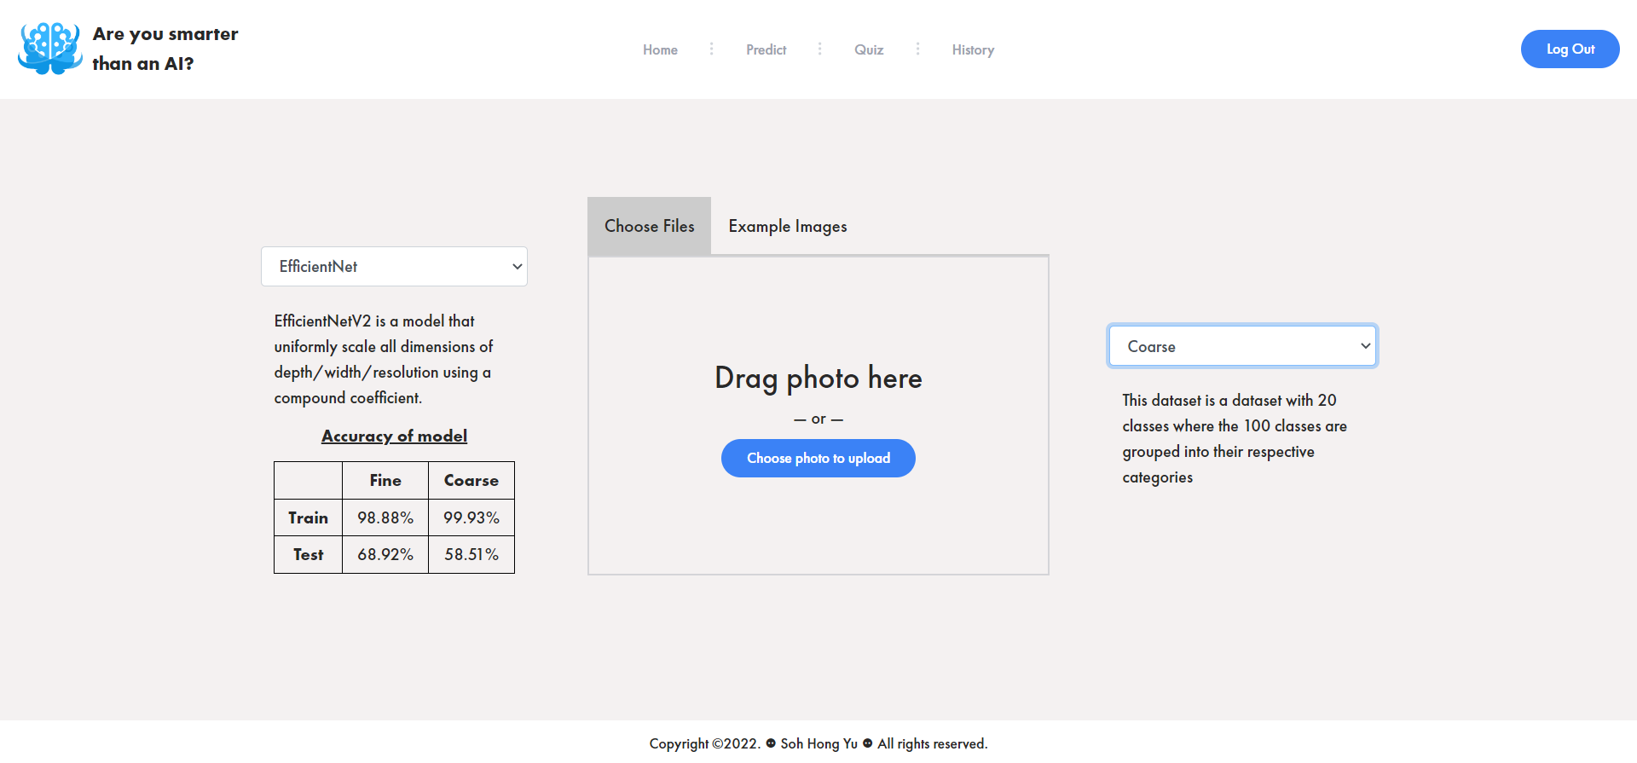
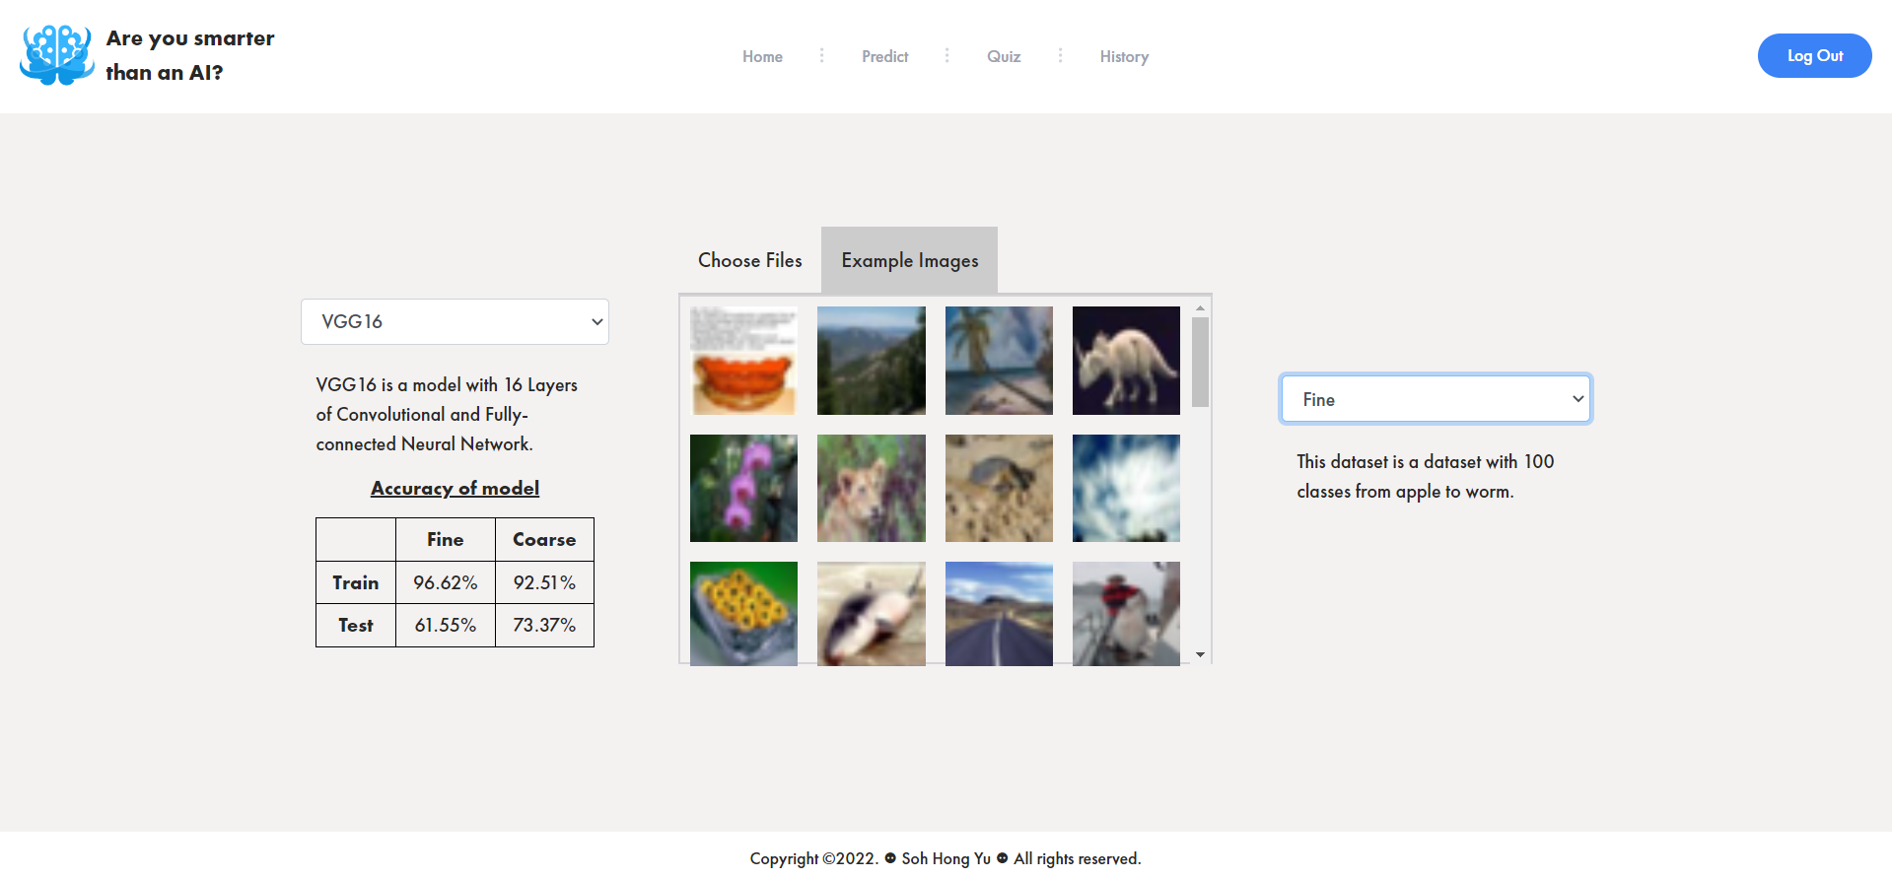
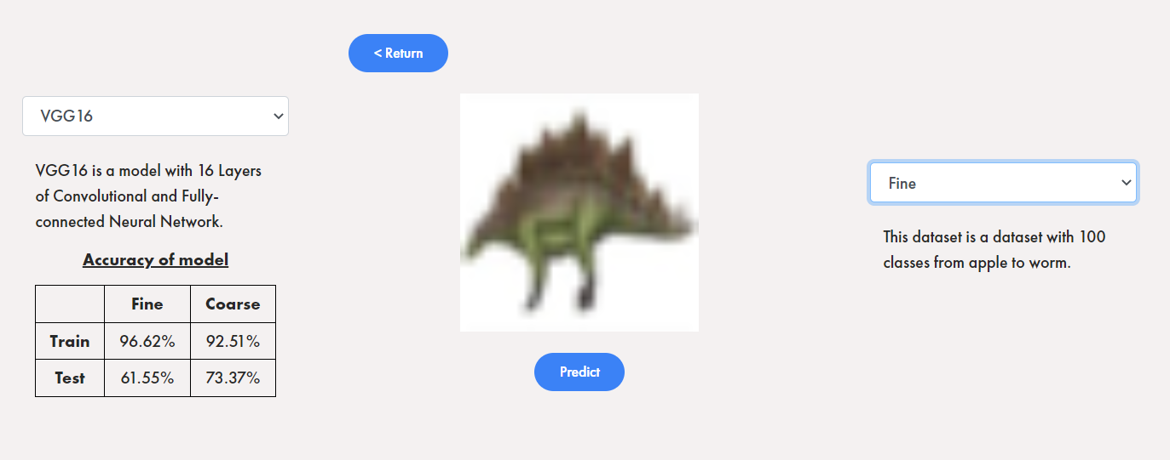
Are You Smarter than an AI? - Prediction
Users can choose to upload an image or choose from the existing images.
Users can also select which model VGG16 or EfficientNet as well as which Dataset is it from like Fine or Coarse.
After selection, the predict button will appear for the user to click to place the prediction.

Slide 18
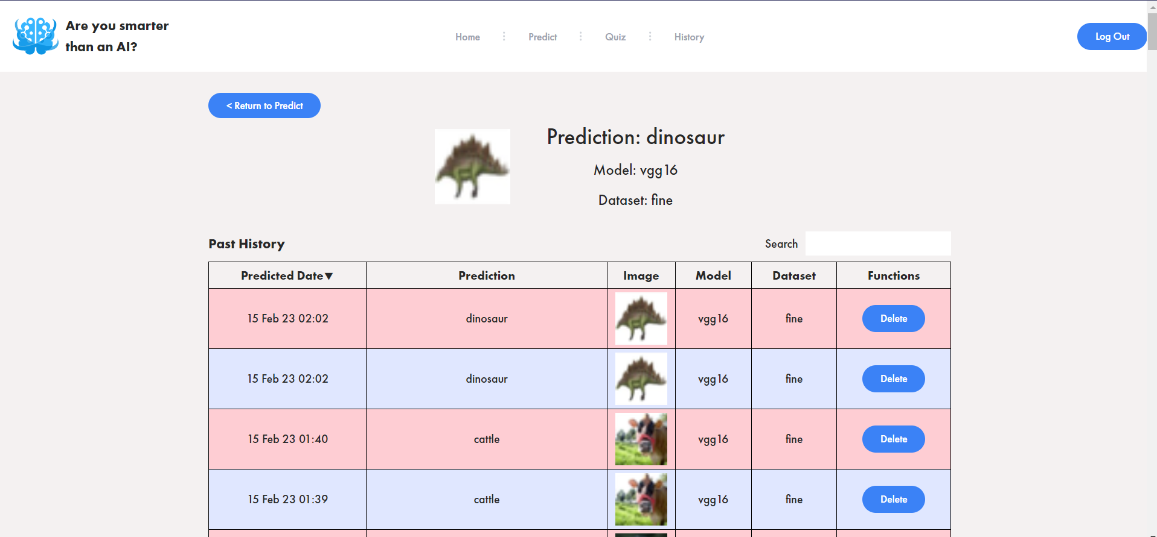
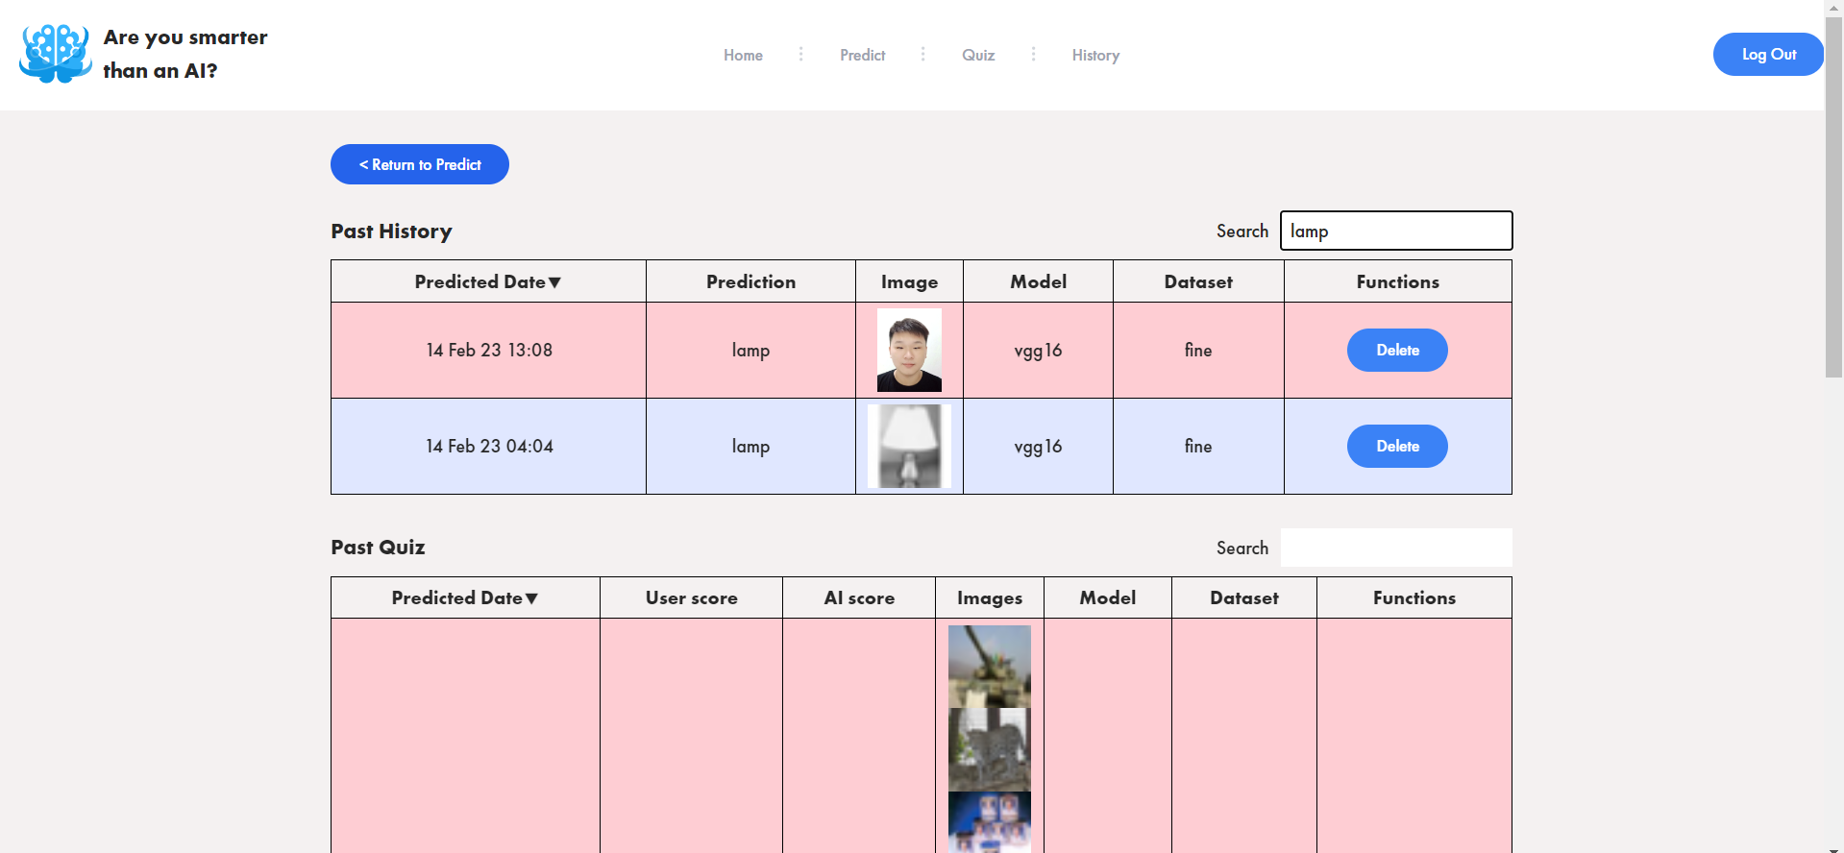
Are You Smarter than an AI? - History
After predictions, users will be moved to the history page where the list of past prediction can be found. One can use the search function as well as delete function.

Slide 19
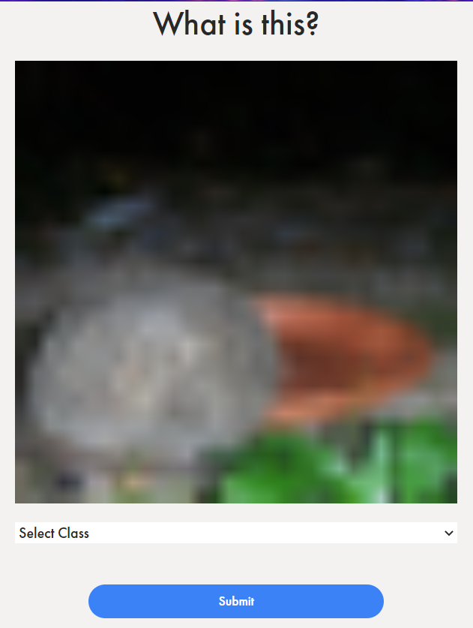
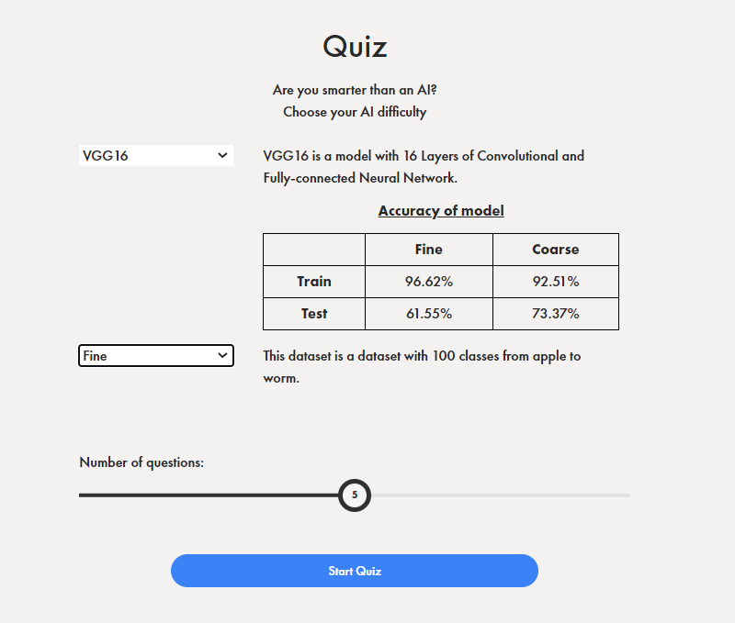
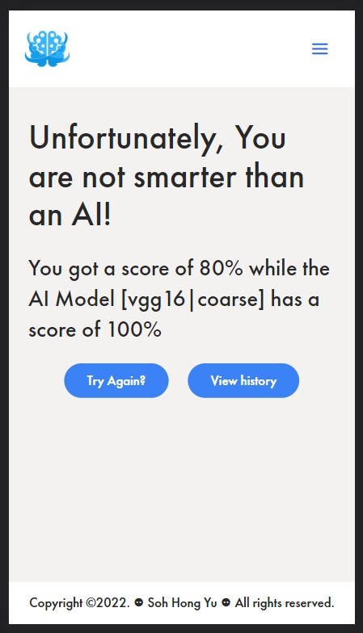
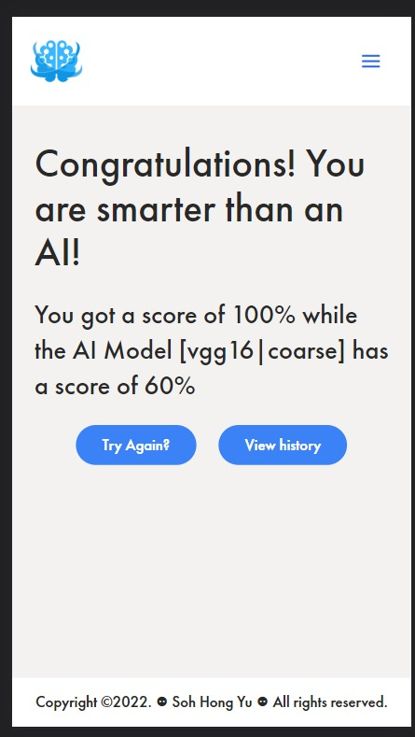
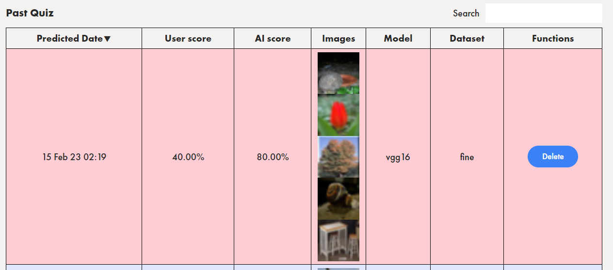
Are You Smarter than an AI? - Quiz
Users can choose the difficulty of the quiz by choosing which model they would want to compete against.
They can choose the number of questions they want to compete against!
Users will be shown an image and a dropdown to allow them to choose what they think the image is about.

Slide 20
Robotics
Process Automation

Slide 21
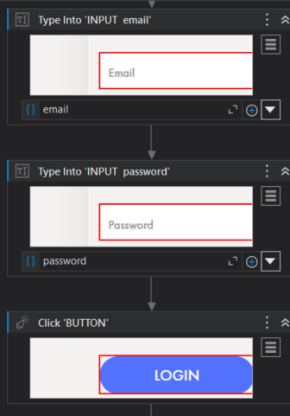
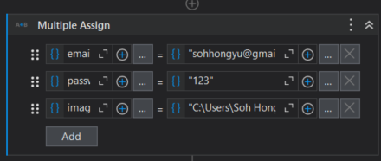
Login RPA
Using UIPath as our RPA robot, we will be first assigning and giving information to the bot so that it knows what to type in the input boxes.
We will use the “Type Into” activities to type into the input boxes. Afterwards, we use the “Click” activity to click on the login button.

Slide 22
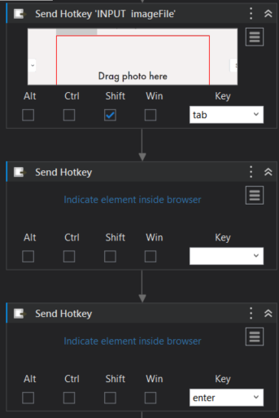
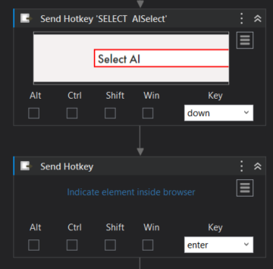
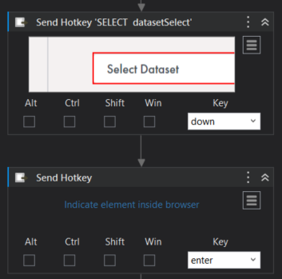
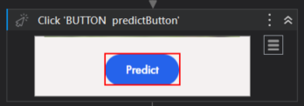
Predict RPA
As there are multiple models to predict from, we will be using the more stable model [VGG16 - Due to latency and small architecture]. (For DEMO purposes)
We will also be using the FINE dataset to allow for the model to be more accurate at pinpointing the class that the image is supposed to be.

Slide 23


Search + Delete RPA
After predicting, we want to be able to interact with the “Delete” buttons to delete entries! We also want to be able to see if the search for the application works!
We will be using “Type Into” activity to search for entries and
“Click” activity to delete the entry

